Slide 1
Power Consumption Forecasting
A Data-Driven Approach Using Environmental and Meteorological Features
Presented by: Sai Subba Rao Mahendrakar

Slide 2
Project Overview:
Goal: Predict power consumption using environmental data (temperature, humidity, wind, etc.)
Location: Zone 1, Wellington, New Zealand
ML Task: Regression
Dataset Size: 52,583 rows × 9 columns
Libraries Used: Pandas, NumPy, Seaborn, Scikit-learn

Slide 3
Data Understanding:
Initial Observations:
Object columns: Temperature, Humidity, Wind Speed
Target Column: Power Consumption in A Zone
No duplicates
Minimal missing values

Slide 4
Data Cleaning:
Dropped unnecessary columns: S no
Renamed target column
Converted object data to numeric
Handled invalid entries with errors='coerce'
Dropped rows with missing values (all <1%)

Slide 5
Feature Selection:
Retained:
Temperature (corr = +0.558)
Humidity (corr = –0.230)
Wind Speed (corr = +0.204)
General Diffuse Flows (corr = +0.208)
Cloudiness (weak, but binary — kept for experimentation)
Dropped:
Diffuse Flows (redundant)
Air Quality Index (low correlation)

Slide 6
Outlier Detection:
Method: IQR Capping
Applied to: Temperature, Humidity, General Diffuse Flows
Logic: Replace values beyond 1.5×IQR range with upper/lower bounds
Wind Speed and Power Consumption had no significant outliers
Cloudiness: Binary → Outlier detection not applicable

Slide 7
Exploratory Data Analysis:
Temperature: Strong positive correlation with power consumption
Humidity: Weak negative correlation
Wind Speed: Non-linear behavior; clustered around 0 and 5
General Diffuse Flows: No clear trend; potentially non-linear

Slide 8
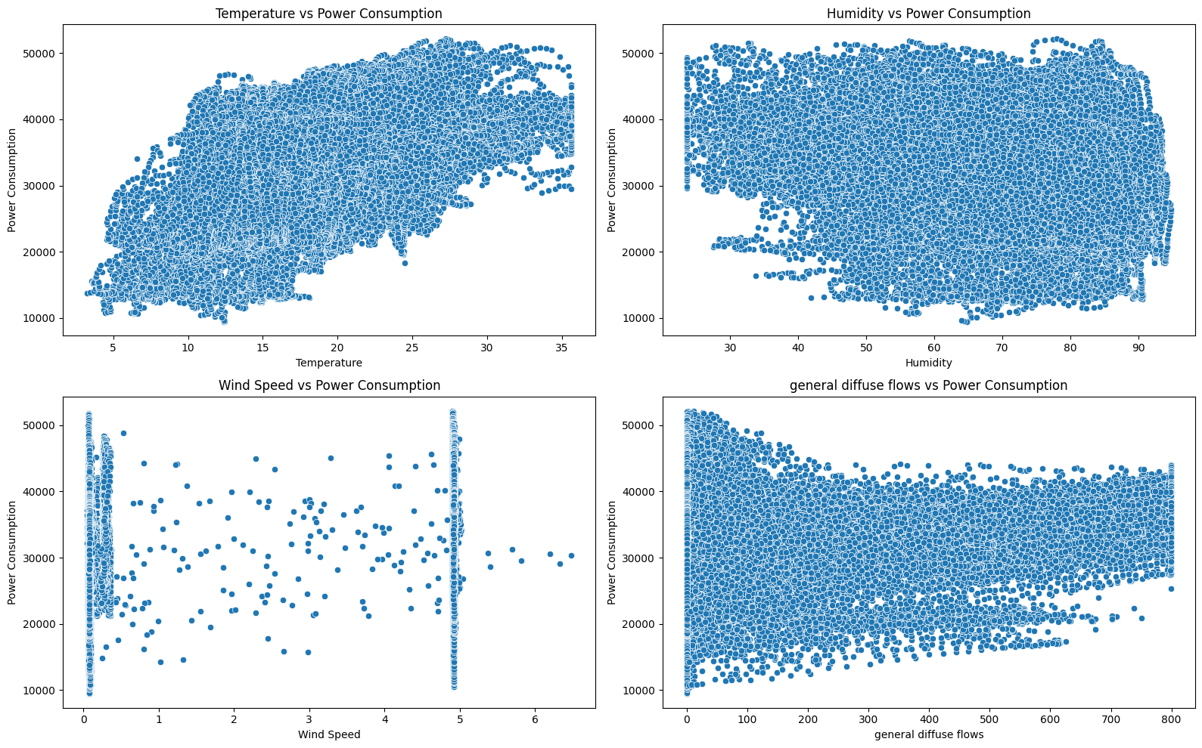

Slide 9
Train-Test Split:
Split Ratio: 80% Train | 20% Test
Shapes:
X_train: (41712, 5)
X_test: (10428, 5)

Slide 10
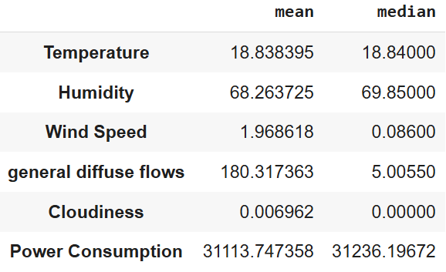
Data Preprocessing:
Skewness Detection:
Based on mean vs median
Log1p Transformation:
Wind Speed
General Diffuse Flows
Standard Scaler:
Applied after train-test split
Prevents data leakage

Slide 11
Model Building:
Algorithm Used: Random Forest Regressor
Why? Performs well amoung all regression models
Training Done on scaled and transformed features

Slide 12
Model Evaluation:
MAE: 3382.14
RMSE: 4913.97
R²: 0.6224
Cross-Validation (5-fold): Avg R² = 0.6068 Shows consistent generalization across splits

Slide 13
Interpretation of Results:
MAE ~3382 → Average error in kWh
RMSE ~4913 → Higher due to extreme points
R² = 62.2% → Good for environmental data
Model captures general trends but not fine-grained variation

Slide 14
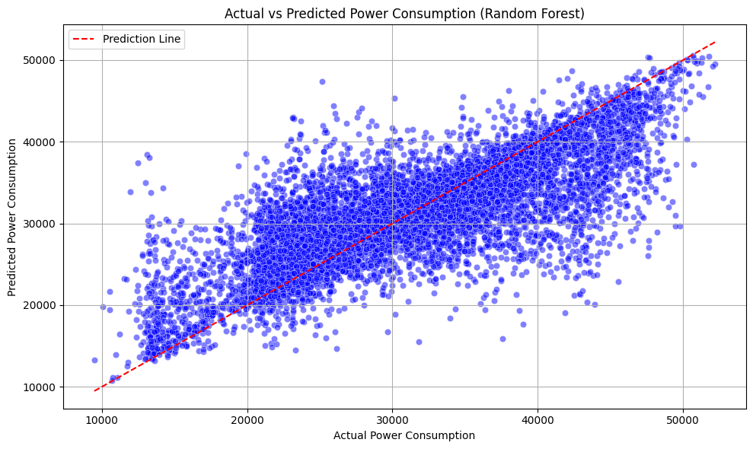
Actual vs Predicted Scatter Plot:

Slide 15
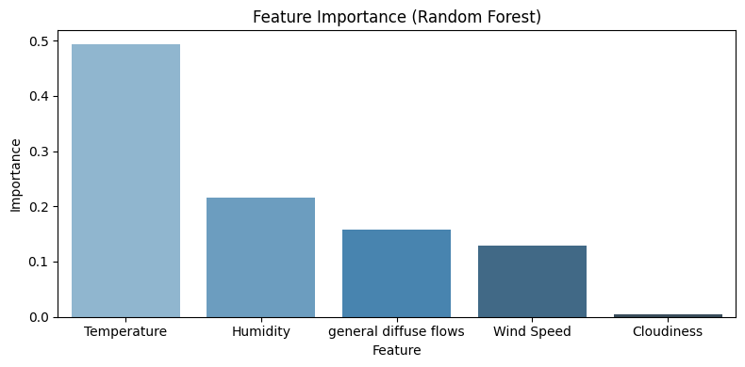
Feature Importance:

Slide 16
Insights & Takeaways:
Temperature is the strongest driver of power demand
Wind and GDF may interact with other features in non-obvious ways
Binary cloudiness has little direct impact

Slide 17
Conclusion:
Cleaned, preprocessed, and modeled environmental data to predict power usage
Random Forest achieved 62% variance explanation
Project demonstrates the real-world value of ML in smart energy forecasting

Slide 18
Links & Contact:
LinkedIn: Sai Subba Rao Mahendrakar
GitHub: saisubbaraom2003
Portfolio: Sai Subba Rao Mahendrakar
Email: mahendrakar2003@gmail.com

